Slide 1

Data MJB
Real Estate Market
Xuya Jiang, Yanbin Liu, Weili He
Ruitong Zhu, Avyay Sah, Tony Nie

Slide 2
Introduction
Project Introduction
Model Description
User
Market Review
& Analysis
Data Resources
Accuracy

Slide 3
Market Analysis
Zillow Zestimate: statistical and machine learning models to estimate home prices.
Shanghai is one of the largest housing markets, attracting investments from investors and homebuyers
There is a demand for models to provide price prediction for Shanghai

Slide 4
Objective
Huge amounts of historical data not utilized
Analyze the historical price impact on the nowadays real estate market
Demonstrate all the factors correlation and impact on the price
Show the expected value for the specific needs from users

Slide 5
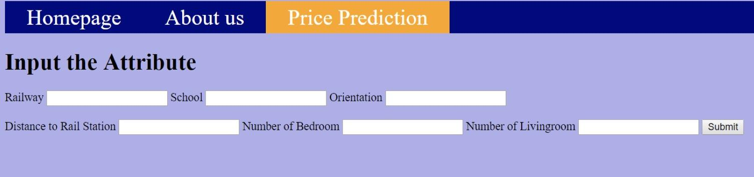
Objective

Slide 6
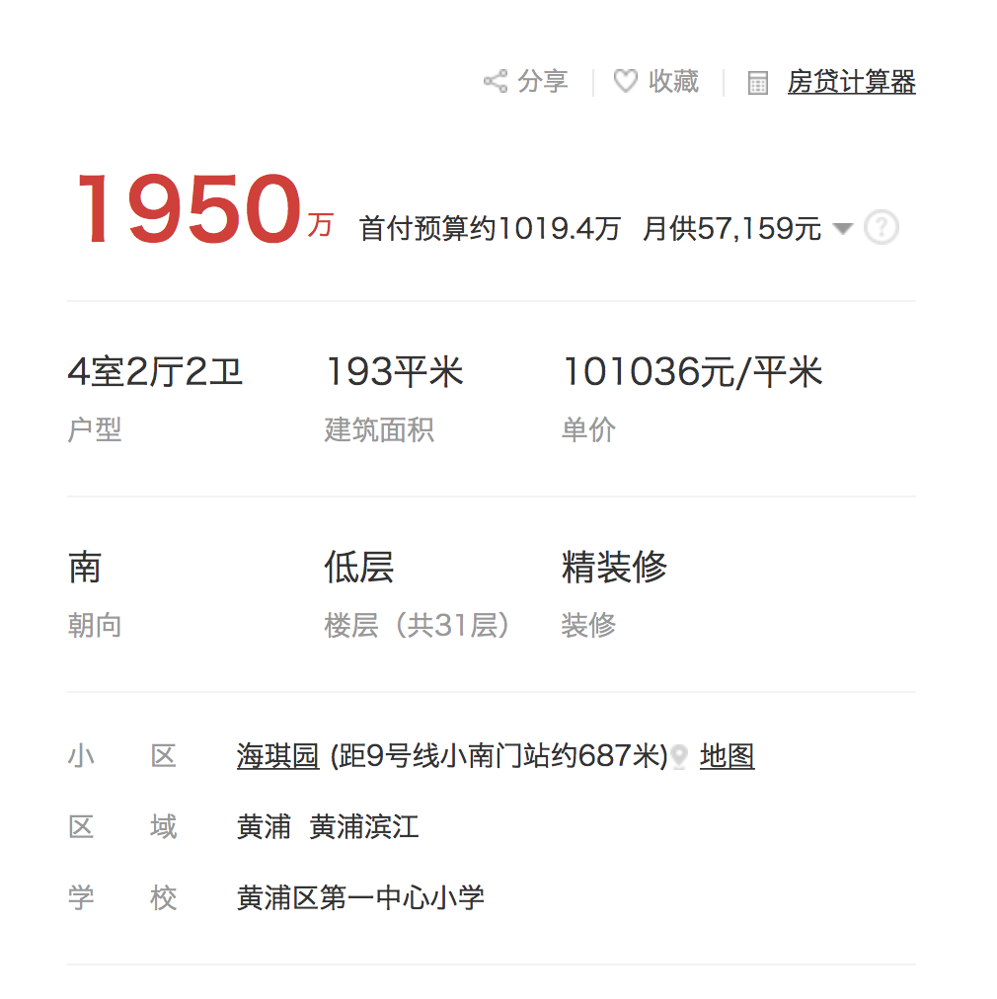
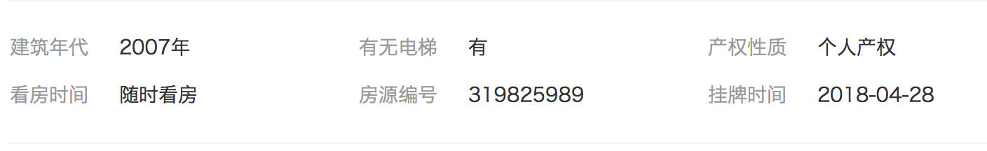
DATA DESCRIPTION
≈$16,000
Price
per square meter (in RMB)
Notes:
Our data is mainly scripted from a website called fang.com, and im gonna illustrate how we utilize the website to get the data. Let’s take this screen shot as an example. We have two price here, but according to the literatures, we are not using the total price, but price per square meter as the dependent variable in our model. And in this example, the price is a hundred thousand yuan, which is 16 thousand in us dollars.
Other features shown in the figure are expalnatory variables, i’m gonna talk about some of them in detail, and quickly go through others.

Slide 7
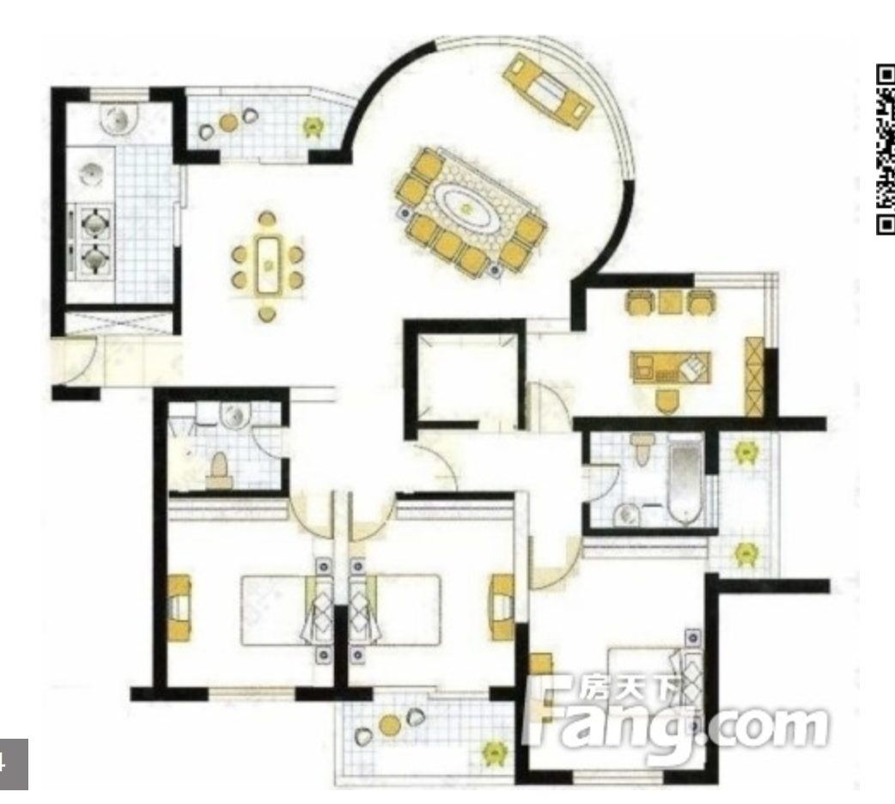
DATA DESCRIPTION
Floor plan
# of bedroom: 4
# of living room : 2
# of bathroom: 2
Total floor area: 193
Notes:
First is the information on the floor plan. From the blue circle, we can derive the number of bedrooms, which is 4, ….The red circle, indicates the total floor area, which is 193 square meters.

Slide 8
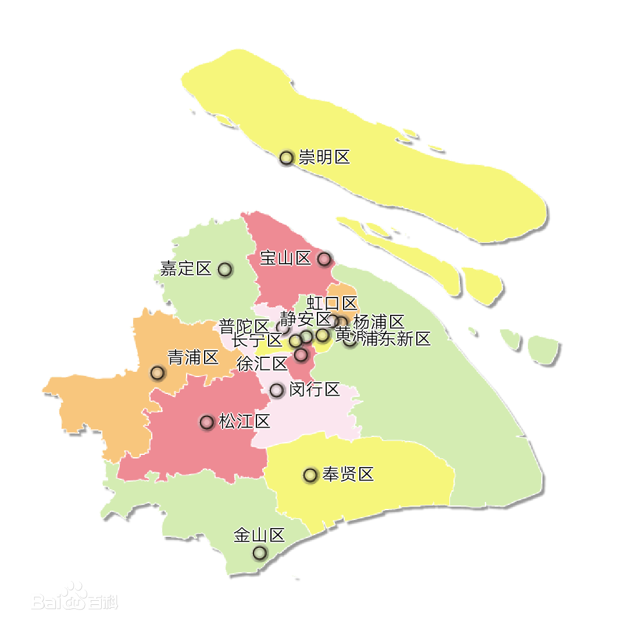
DATA DESCRIPTION
Location
Notes:
Another important feature is the location of the apartment.
Instead of longitude and latitude, here we take the administrative region that the apartment belongs to as a feature.
Let’s say Shanghai has 16 districts and each district has several neighborhoods, and we are gonna take these neighborhoods as a categorical variable. For example, this apartment is in the xx neighborhood of huangpu district.

Slide 9
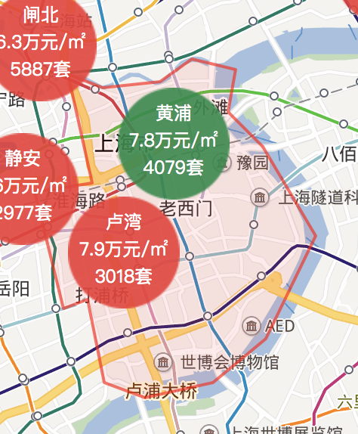
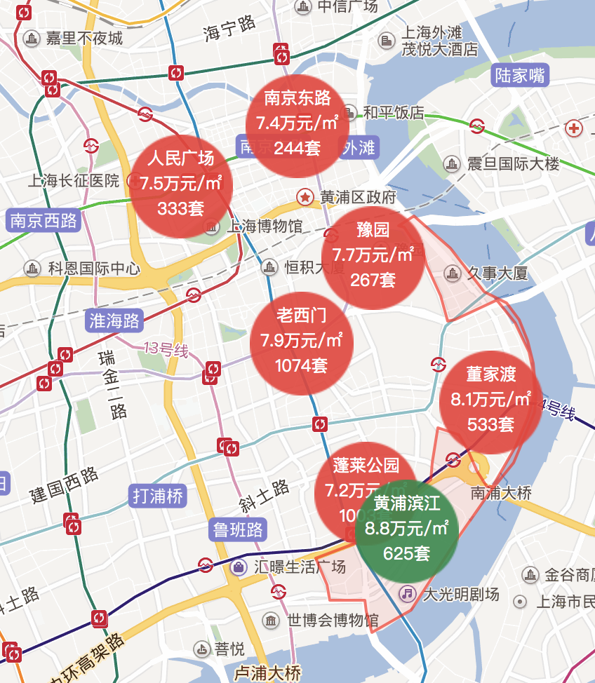
DATA DESCRIPTION
Location
Notes:
16 districts

Slide 10
DATA DESCRIPTION
Bedroom | Living room | Bathroom | Floor area
Numerical | Numerical | Numerical | Numerical
Orientation | Decoration | Subway | Location
Categorical | Categorical | Numerical | Categorical
School | Year built | Elevator | Price
Categorical | Numerical | Categorical | Numerical
Notes:
Besides,

Slide 11
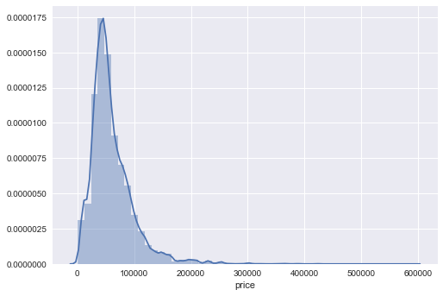
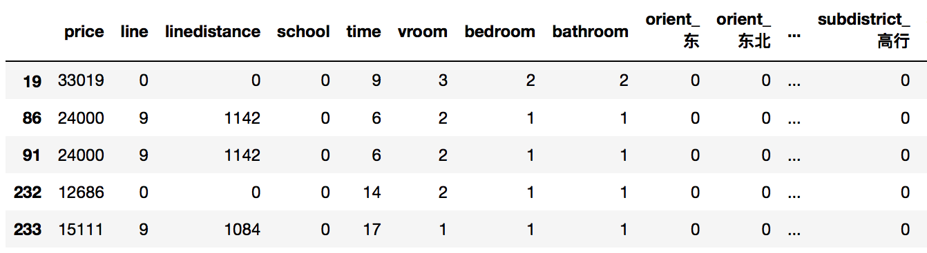
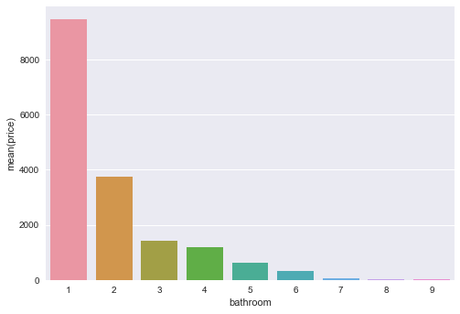
DATA DESCRIPTION
Notes:
After these analysis, we made a scraper and scrapped around 20 k rows of data. Here is what our data look like in python.
Histagram of the price,

Slide 12
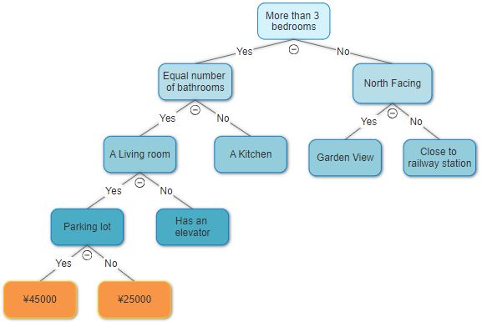
MODEL DESCRIPTION
RANDOM FOREST
A Decision Tree based on feature selection classifies the data and reaches to a conclusion
Example of a Decision Tree deciding on the price of an apartment.

Slide 13
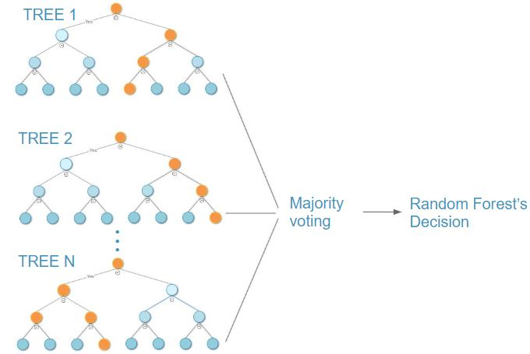
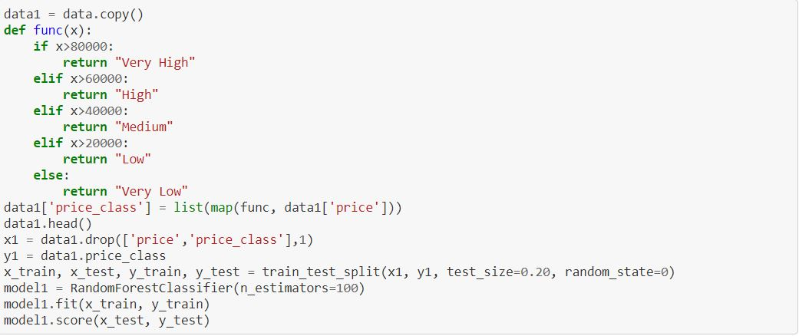
MODEL DESCRIPTION
RANDOM FOREST
Trained a model using both regressor and classifier technique.
For the regressor type we kept the trees limit to 100.
For the classifier type, we trained 2 model, one with 5 labels and one with 3 labels.

Slide 14
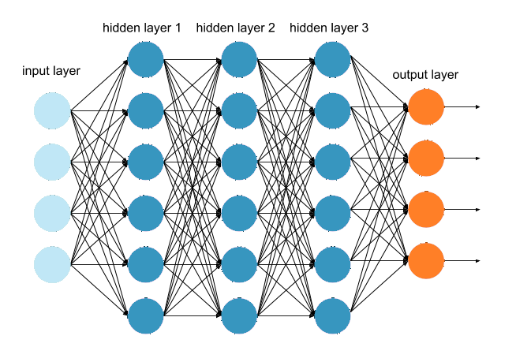
MODEL DESCRIPTION
Dense Neural Network
The Dense Neural Network model we trained comprised of three hidden layers.
The layers had 500, 300 and 100 neurons each and we used ‘tanh’ as the activation function.
Loss function used was ‘RMSE’
Trained the model in batches of 100, running it for 2000 iterations.

Slide 15
Definition of Accuracy
We use confidence interval ß
Accurate
Of Regression
|prediction - actual|<ß*actual

Slide 16
Accuracy Change along our path
Old Data
ß=15%
Accuracy 30%
Both DNN & RFR
New Data
ß=15%
Accuracy 55%
DNN
New Data
ß=15%
Accuracy
66%
RFR
New Data
Accuracy
75% with 5 labels
85% with 3 labels
RFC

Slide 17
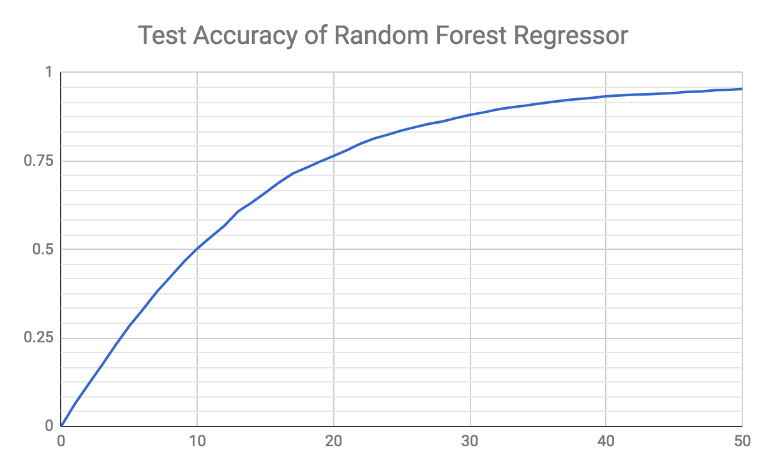
Accuracy
ß

Slide 18
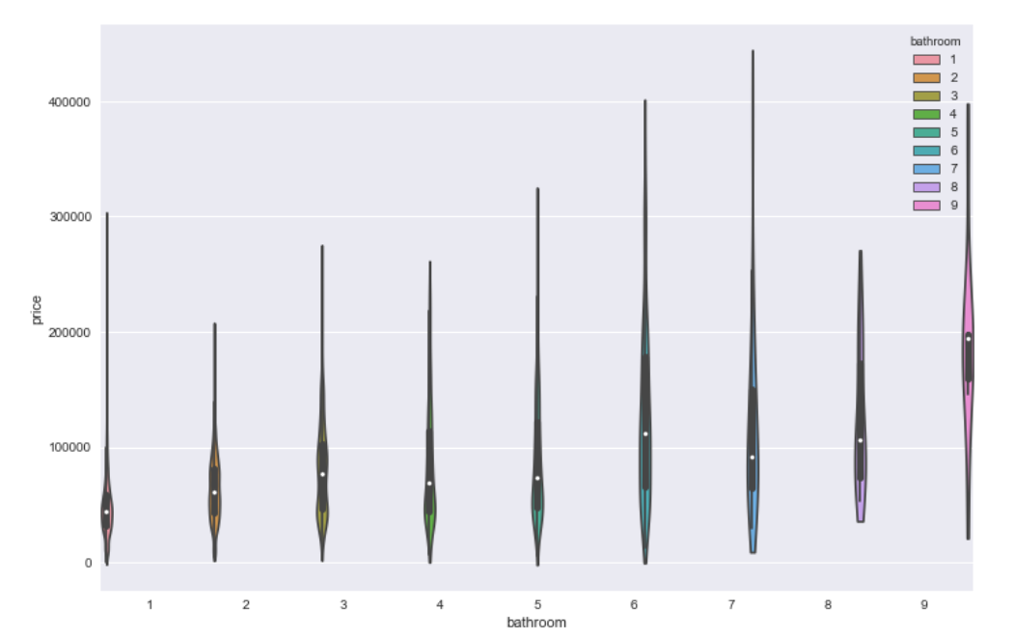

Slide 19
Price Index
(Weighted Average)
Time Series(ARIMA)
Total Price
Price Premium
( Price-Index)
RandomForest

Slide 20
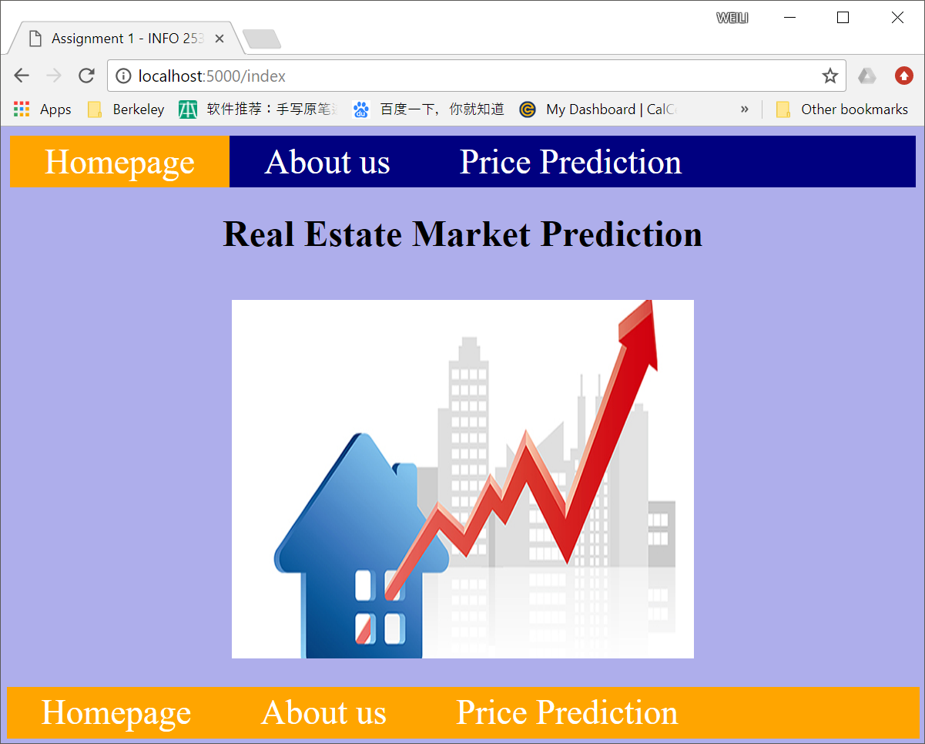
User Interface

Slide 21
Summary
Problems we solved.
How do we get to the final solutions.
Techniques we used
What to do in the future
Notes:
1.Fit the model. What feature is the most important? (landmark in the district)
2. We first tried to use the API, but request did not passed. Then scrape the data from the web page, just a few features like district, area, parking lot, green rate. We then further look into an detailed agency analysis to scrape the information to find whether the keyword like ‘gym’, ‘swimming pool’, ‘school’ is in it. But due to a lot of invalid data, we switched to another effective data source and scraped 18000 non repeated rows of data. Those features are just what we mentioned before. Then we used NN and Random Forest to get the model, compare accuracies. Last built a simple user interface.
3. Web scraping, data cleaning, modeling, web architecture

Slide 22
THANKS!
Any questions?

Slide 23
Problem we are trying to solve
Shanghai is one of China’s largest housing markets.
Valuable to gain insight into correlation between features of a property and its price.
Objective was to develop a model that learned from real estate listings in Shanghai.
The model can then be used to predict the value of a property given a set of features.

Slide 24
Project Introduction
Real Estate Market Prediction in Shanghai

Slide 25
Future Work
Getting more data for the existing model
Trying to use time series to do prediction of future
Prettifying the User Interface

